Slide 1
Aptitude training Sharpen Your Problem-Solving Skills

Slide 2
TIME, SPEED AND DISTANCE

Slide 3
D
Speed = Distance/Time;
Time = Distance/Speed
Distance = Speed × time
S
T

Slide 4
Time and Distance
Car / Cycle / Man
Problems on Trains
Platform / Tunel
Boats and Streams
Upstream / Downstream

Slide 5
TIME
÷ 60 × 60
1 min = 60 secs 60 mins = 1 hour 1 hr = 3600 secs
=60 mins * 60 secs
× 60 ÷ 60
4 hr 30 mins 5 hr 15 mins 6 hr 45 mins
4.50 hrs 5.25 hrs 6.75 hrs

Slide 6
DISTANCE
1 KM = 1000 M

Slide 7
SPEED
Km/hr m/sec
18/5
Example : 90 Km/hr m/sec
5/18

Slide 8
NOTE :
60 Km/hr – Car speed is reduced by 20 km/hr 40 km/hr
60 Km/hr – Car speed is reduced to 20 km/hr 20 km/hr
Two car travelling in a opposite direction ( + speed )
Two car travelling in a same direction ( - speed )

Slide 9
How long it will take a person walking at 5 km/hr to cover 20 km ?
The speed of a bus is 72km/hr . The distance covered by the bus in 5 sec is
a) 100m b) 60m c) 50m d) 74.5m

Slide 10
3. A person walks at a speed of 5 km/h. How much time will he take to cover a distance of 20 kilometers?
4. A boat can travel at 10km/h in still water. If the speed of the current is 2km/hr, how long it will take to travel 12km downstream ?

Slide 11
5. A boat can travel at 8 km/h in still water. The speed of the current is
3km/h. How long will it take the boat to travel 15 km upstream?

Slide 12
6. A car travelling at a speed of 40km/hr can complete a journey in 9 hr. How long will it take to travel the same distance at 60km/hr ?
7. Two cyclists starts at the same time from two points A and B, which are 120km apart. If they move towards each other at speeds of 20km/hr and 30km/hr respectively, how long will it take before they meet ?

Slide 13
8. Kamal left for the city A from city B at 5:20 Am. He travelled at a speed of 80km/hr for 4hours 15min. After that, the speed was reduced to 60km/hr. If the distance between two cities is 350km, at what time did Kamal reach City A
a) 9:20 AM b) 9:25 AM c) 9: 35 AM d) 9: 45 AM

Slide 14
RATIO AND Proportion

Slide 15
RATIO : A ratio is a comparison of two products or quantities.
2 : 1 => a : b or a/b
PROPORTION : Equality of two ratios
1 : 2 : : 4 : 8 => a : b : : c : d
1 : 2 = 4 : 8
1/2 = 4/8

Slide 16
Types of Ratio
Square
Duplicate Ratio ( 3 : 7 ) ( 9 : 49 )
Cube
Triplicate Ratio ( 3 : 7 ) ( 27 : 343 )
Square root
Sub-Duplicate Ratio ( 9 : 25 ) ( 3 : 5 )
Cube root
Sub- Triplicate Ratio ( 125 : 343 ) ( 5 : 7 )
Inverse
Inverse Ratio ( 5 : 7 ) ( 7 : 5 )
Compound Ratio -> 1 : 3 2 : 9 4 : 7
a : b c : d e : f = 1 * 2 * 4
3 * 9 * 7

Slide 17
NOTE : Ratio shouldn’t be in fraction
Example : a : b = 2/9 : 1/3
LCM = 2 : 3
a : b = 2 : 3
a = 2
b = 3
a = 2x
B = 3x

Slide 19
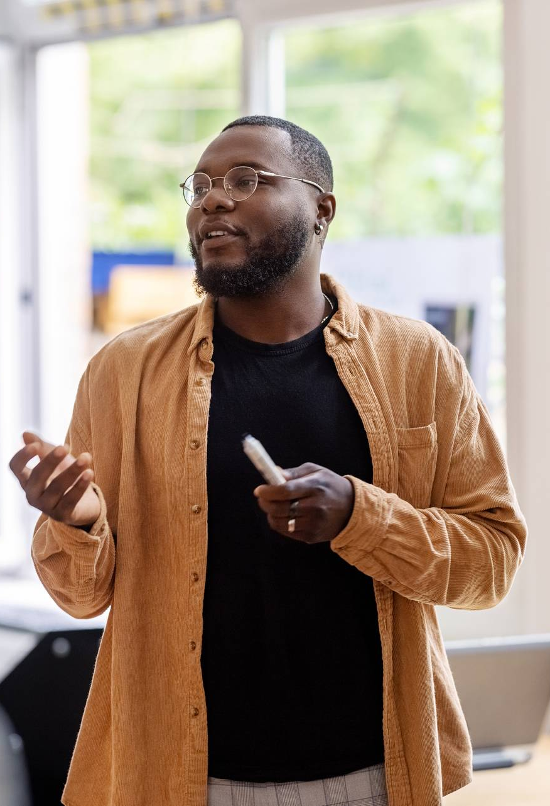
The power of communication

Slide 20
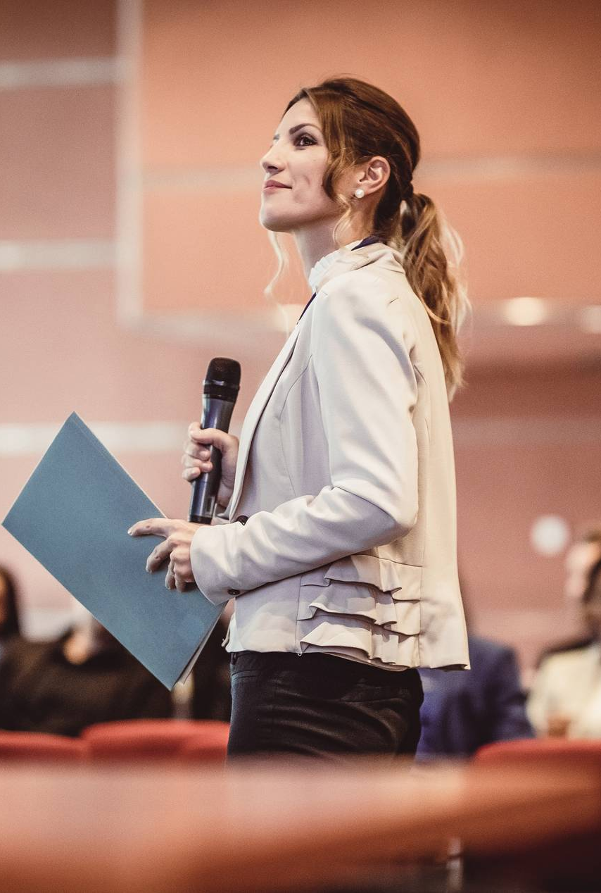
Overcoming nervousness
Confidence-building strategies

Slide 21
Effective delivery techniques
This is a powerful tool in public speaking. It involves varying pitch, tone, and volume to convey emotion, emphasize points, and maintain interest.
Pitch variation
Tone inflection
Volume control
Effective body language enhances your message, making it more impactful and memorable.
Meaningful eye contact
Purposeful gestures
Maintain good posture
Control your expressions

Slide 22

Navigating Q&A sessions
Maintaining composure during the Q&A session is essential for projecting confidence and authority. Consider the following tips for staying composed:
Stay calm
Actively listen
Pause and reflect
Maintain eye contact
Know your material in advance
Anticipate common questions
Rehearse your responses

Slide 23
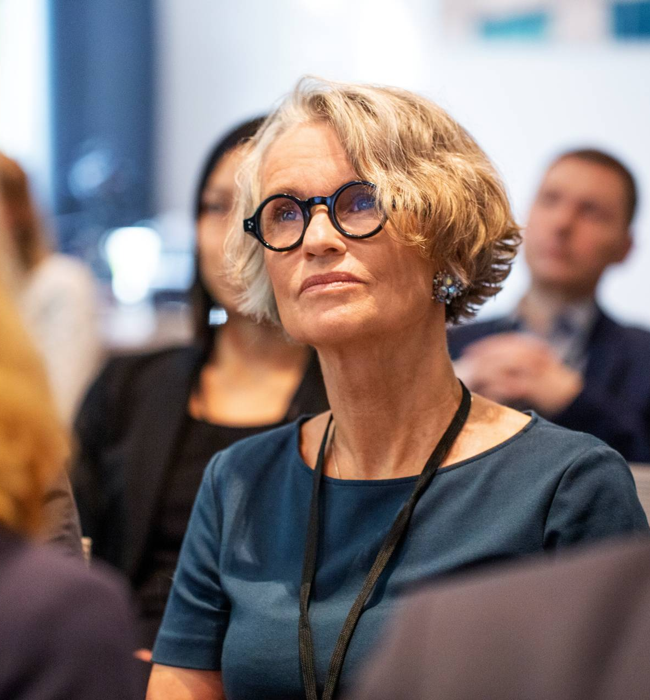
Speaking impact
Your ability to communicate effectively will leave a lasting impact on your audience
Effectively communicating involves not only delivering a message but also resonating with the experiences, values, and emotions of those listening

Slide 24
Final tips & takeaways
Consistent rehearsal
Strengthen your familiarity
Refine delivery style
Pacing, tone, and emphasis
Timing and transitions
Aim for seamless, professional delivery
Practice audience
Enlist colleagues to listen & provide feedback
Seek feedback
Reflect on performance
Explore new techniques
Set personal goals
Iterate and adapt

Slide 25
Speaking engagement metrics
Impact factor | Measurement | Target | Achieved
Audience interaction | Percentage (%) | 85 | 88
Knowledge retention | Percentage (%) | 75 | 80
Post-presentation surveys | Average rating | 4.2 | 4.5
Referral rate | Percentage (%) | 10 | 12
Collaboration opportunities | # of opportunities | 8 | 10

Slide 26
Thank you
Brita Tamm
502-555-0152
brita@firstupconsultants.com
www.firstupconsultants.com

